Slide 1
Infectious Diseases
AN INTRODUCTION TO INFECTIOUS DISEASE

Slide 2
What is an infectious disease?
Infectious diseases are caused by infectious agents (bacteria, viruses, parasites or fungi or their toxic products).
Many are also communicable diseases, meaning they can be passed from one person or animal to another.

Slide 3
The origin of infectious diseases
Some experts say it was approximately 2 million years ago that infectious diseases started originating and spreading
This coincides with rodent species separating and diversifying

Slide 4
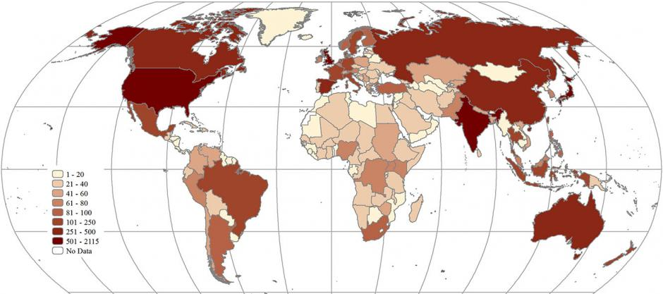
How many are there?
There are currently over 110 infectious diseases, with more being discovered all the time.

Slide 5
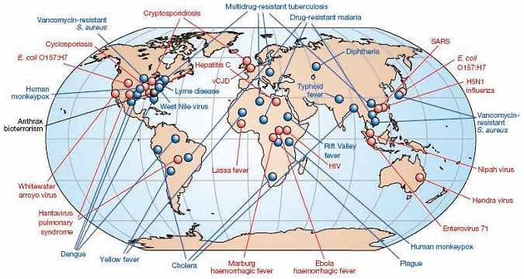

Slide 6
Pathogens
A pathogen is an organism that causes disease.
Your body is naturally full of microbes. However, these microbes only cause a problem if your immune system is weakened or if they manage to enter a normally sterile part of your body.
Pathogens are different and can cause disease upon entering the body.

Slide 7
What do pathogens do?
All a pathogen needs to thrive and survive is a host. Once the pathogen sets itself up in a host’s body, it manages to avoid the body’s immune responses and uses the body’s resources to replicate before exiting and spreading to a new host.
Pathogens can be transmitted a few ways depending on the type. They can be spread through skin contact, bodily fluids, airborne particles, contact with faeces, and touching a surface touched by an infected person.

Slide 8
Types of Pathogens
There are different types of pathogens, but we’re going to focus on the four most common types: viruses, bacteria, fungi, and parasites.

Slide 9
Pathogens: Viruses
Viruses are made up of a piece of genetic code, such as DNA or RNA, and protected by a coating of protein.
Once you’re infected, viruses invade host cells within your body. They then use the components of the host cell to replicate, producing more viruses.
After the replication cycle is complete, these new viruses are released from the host cell. This usually damages or destroys the infected cells.

Slide 10
Pathogens: Viruses
Some viruses can remain dormant for a time before multiplying again. When this happens, a person appears to have recovered from the viral infection, but gets sick again.
Antibiotics do not kill viruses and therefore are ineffective as a treatment for viral infections. Antiviral medications can sometimes be used, depending on the virus.

Slide 11
Pathogens: Bacteria
Bacteria are micro-organisms made of a single cell. They are very diverse, have a variety of shapes and features, and have the ability to live in just about any environment, including in and on your body.
Not all bacteria cause infections. Those that can are called pathogenic bacteria.
Your body can be more prone to bacterial infections when your immune system is compromised by a virus. The disease state caused by a virus enables normally harmless bacteria to become pathogenic.

Slide 12
Pathogens: Bacteria
Antibiotics are used to treat bacterial infections. Some strains of bacteria have become resistant to antibiotics, making them difficult to treat.
This can happen naturally, but also happens because of the overuse of antibiotics, according to the World Health Organization (WHO)Trusted Source.

Slide 13
Pathogens: Fungi
There are millions of different fungal species on Earth. Just 300 or so are known to cause sickness.
Fungi can be found just about everywhere in the environment, including indoors, outdoors, and on human skin. They cause infection when they overgrow.
Fungi cells contain a nucleus and other components protected by a membrane and a thick cell wall. Their structure can make them harder to kill.

Slide 14
Pathogens: Fungi
Some new strains of fungal infections are proving to be especially dangerous, such as Candida auris, and have prompted more research into fungal infections.
Candida auris is multidrug-resistance and is causing outbreaks in healthcare. It causes fevers and chills and has a 30-60% death rate.

Slide 15
Pathogens: Parasites
Parasites are organisms that behave like tiny animals, living in or on a host and feeding from or at the expense of the host.
Though parasitic infections are more common in tropical and subtropical regions, they can occur anywhere.
They can be spread several ways, including through contaminated soil, water, food, and blood, as well as through sexual contact and via insect bites.

Slide 16
Pathogens: Parasites
Three main types of parasites can cause disease in humans. These include:
protozoa, which are single-celled organisms that can live and multiply in your body
helminths, which are larger, multi-celled organisms that can live inside or outside your body and are commonly known as worms
ectoparasites, which are multi-celled organisms that live on or feed off your skin, including some insects, such as ticks and mosquitos

Slide 17
How do infectious diseases spread?
Infectious diseases commonly spread through the direct transfer of bacteria, viruses or other germs from one person to another.
This can happen when an individual with the bacterium or virus touches, kisses, or coughs or sneezes on someone who isn't infected.

Slide 18
The infectious diseases we will look at in more detail
Tuberculosis
HIV/AIDS
Ebola
Malaria
Zika Virus
SARS
COVID-19
Influenza
Lyme Disease
E.coli
Salmonella
Chickenpox
Measles
Mumps
Rubella
Sexually Transmitted Diseases
Zombie Virus
Flesh Eating Disease
SUPER BUGS (e.g. MRSA)

